Slide 1
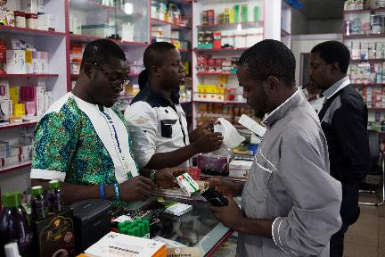

[Country, Year]
Antimalarial Audit Test

Slide 2
INSTRUCTIONS FOR TEST
Print out antimalarial audit sheets (5 per person) and RDT audit sheets (2 per data collector).
Print out the price and volume information sheets that correspond with the products.
Ensure each product (5 AMs and 2 RDTs) has been labelled with letters (A,B,C,... etc.).
Instruct the data collectors that they will have 7 minutes per product, and should complete all relevant information in the audit sheet for each product. They should work alone and in silence.
Start by giving one product to each data collector.
After 7 minutes, everyone should pass the product to their right.
By the end of the exam, all data collectors should have recorded information for every product

Slide 3
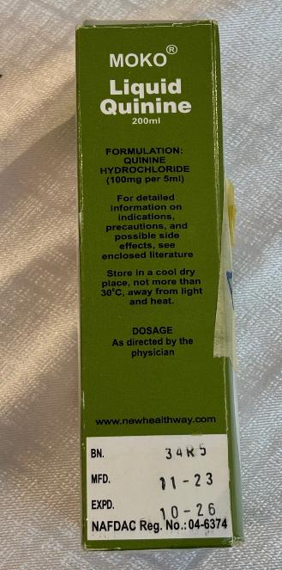
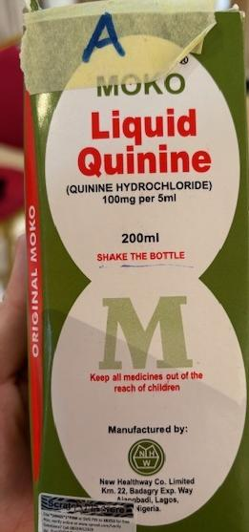
Antimalarial Product A
Note: update with project country currency and pricing.
This product never goes out of stock.
They have sold 4 of this product in the past week to retail customers. Each one is sold for XX. The last time they bought this from their wholesaler, they bought 100 packs. This cost XX. They do not sell to other providers or outlets.

Slide 4
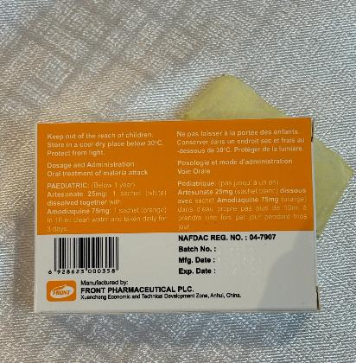
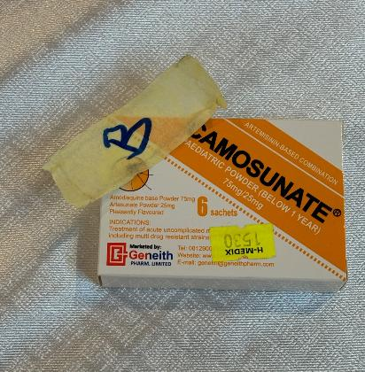
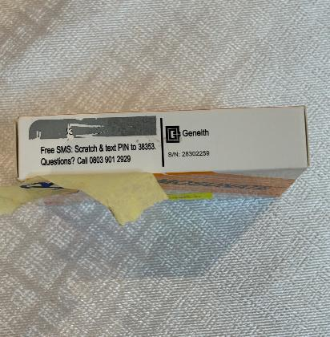
Note: update with project country currency and pricing.
This product was out of stock for a week in May, but otherwise is always in stock.
Malaria season is warming up, and they have sold 12 of this product in the past week to retail customers. Each one is sold for XX. The last time they bought this from their wholesaler, they bought 25 packs which cost XX. The minimum order size if they sell to other outlets is 10 packs, for XX per pack.
Antimalarial
Product B

Slide 5
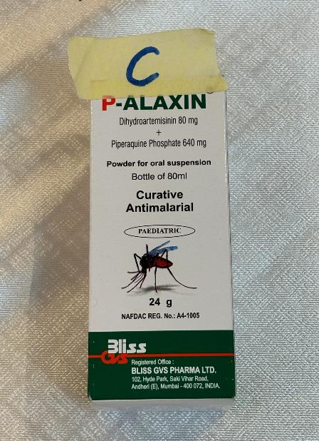
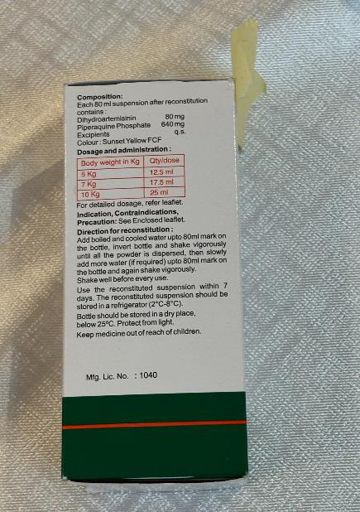
Note: update with project country currency and pricing.
Antimalarial Product C
The outlet did not have this in stock before last week. They have since sold 2 packs for XX each. They refuse to tell you about their wholesale practices, either buying or selling.

Slide 6
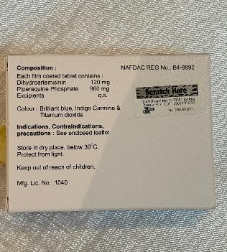
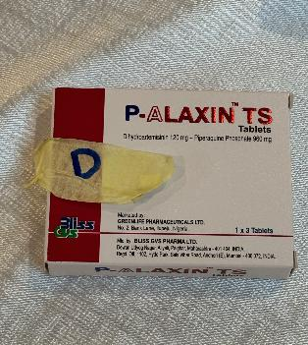
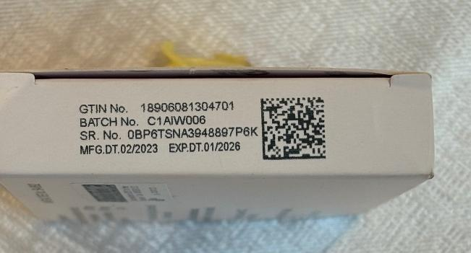
Antimalarial Product D
Note: update with project country currency and pricing.
This product has not been out of stock since December 2023. They sell on average 4 packs per month, but can’t remember what happened last week. They sell them for XX to retail customers and to wholesale customers. There is no minimum order size. When they buy them wholesale, they cost XX each. Last time they bought 10.

Slide 7
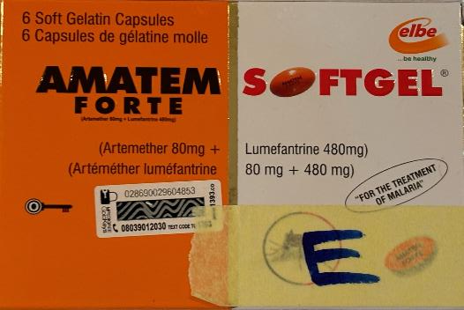
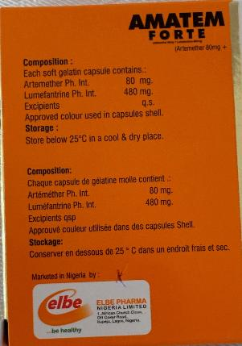
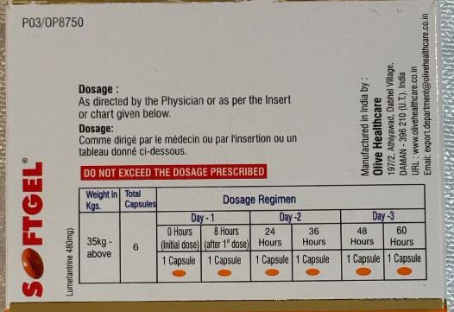
Antimalarial Product E
Note: update with project country currency and pricing.
This is their best-selling product! They sold all their stock 2 weeks ago and it took a week to get more. They sell for XX per pack. They refuse to tell you about their wholesale practices.

Slide 8
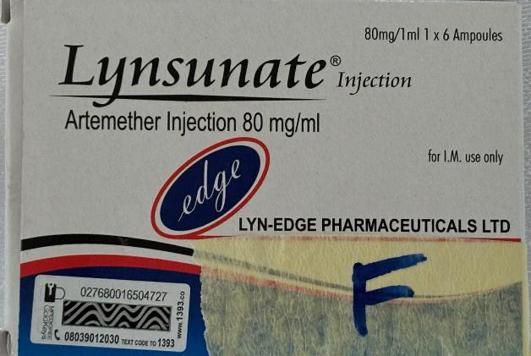
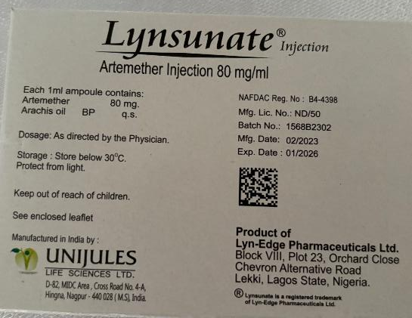
Note: update with project country currency and pricing.
Antimalarial Product F
This product rarely goes out of stock, but the provider can’t remember if it has in the past 3 months. It sells for XX to any customer type. They have sold 2 in the past week. 1 to retail and 1 to another outlet type. They buy them in lots of 5 from their wholesaler for XX each.

Slide 9
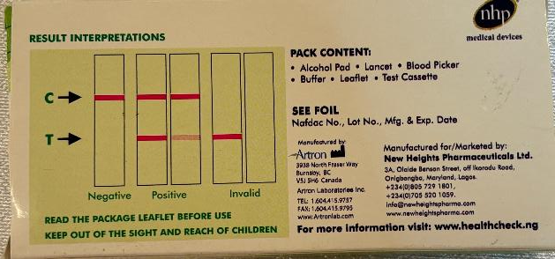
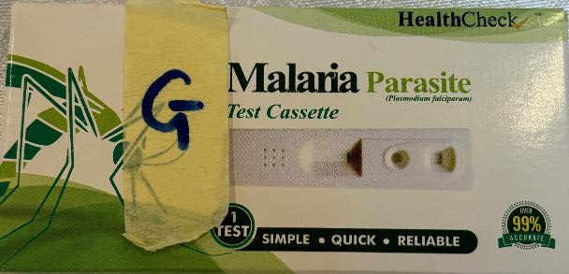
Note: update with project country currency and pricing.
RDT
Product G
The provider has sold 6 of these this week for take-away (XX). They do not offer in-house testing. Children get no discount. They were out of stock earlier this month. They buy them in batches of 50 from their supplier for XX. They do not sell to other outlets

Slide 10
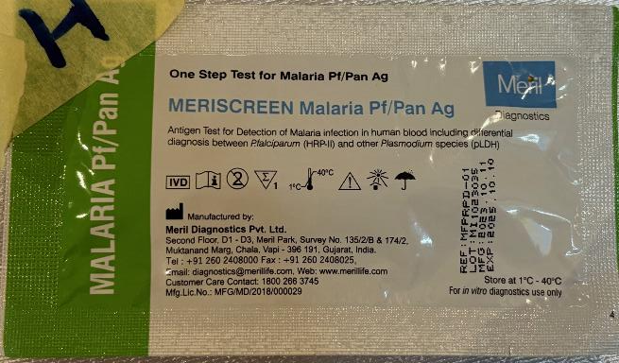
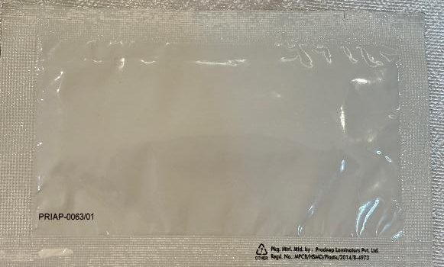
Note: update with project country currency and pricing.
The provider does not sell these for take away testing. In house, they charge XX for the test and XX for the service for adults, but only XX total (including test) for children. They are reluctant to tell you about their wholesale practices, except that last time they received 100 of these tests for free from an NGO.
RDT
Product H

Slide 11
ANSWERS

Slide 12

Product A
Note: update with project country currency and pricing.
This product never goes out of stock.
They have sold 4 of this product in the past week to retail customers. Each one is sold for XX. The last time they bought this from their wholesaler, they bought 100 packs. This cost XX. They do not sell to other providers or outlets.
Brand: MOKO LIQUID QUININE
Generic/ active ingredients: QUININE
Manufacturer + country: NEW HEALTHWAY + NIGERIA
Strength(s): 100MG / 5ML
Dose form: SUSPENSION
FDC?: N/A
Salt: YES - HYDROCHLORIDE
Pack type: BOTTLE
Pack Size: 200ML
Quantity sold: 4 BOTTLES
Stockout?: NO
Price for retail: XX
Price for wholesale: N/A
Price paid to supplier: XX FOR 100

Slide 13
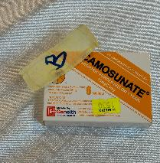
Product B
Note: update with project country currency and pricing.
This product was out of stock for a week in May, but otherwise is always in stock.
Malaria season is warming up, and they have sold 12 of this product in the past week to retail customers. Each one is sold for XX. The last time they bought this from their wholesaler, they bought 25 packs which cost XX. The minimum order size if they sell to other outlets is 10 packs, for XX per pack.
Quantity sold: 12 PACKS
Stockout?: YES
Price for retail: XX
Price for wholesale: XX FOR 10 PACKS
Price paid to supplier: XX FOR 25 PACKS
Brand: CAMOSUNATE PEDIATRIC
Generic/ active ingredients: AMODIAQUINE ARTESUNATE
Manufacturer + country: FRONT PHARMACEUTICAL + CHINA
Strength(s): 75MG / 25MG
Dose form: GRANULES
FDC?: N/A
Salt: NO
Pack type: INDIVIDUAL PACKAGE OR SACHET
Pack Size: 6 OR 1

Slide 14

Product C
Note: update with project country currency and pricing.
The outlet did not have this in stock before last week. They have since sold 2 packs for XX each. They refuse to tell you about their wholesale practices, either buying or selling.
Brand: P-ALAXIN
Generic/ active ingredients: DIHYDROARTEMISININ PIPERAQUINE
Manufacturer + country: BLISS GVS + INDIA
Strength(s): 80MG/80ML & 640MG/80ML
Dose form: SUSPENSION
FDC?: N/A
Salt: YES- PHOSPHATE
Pack type: BOTTLE
Pack Size: 80ML
Quantity sold: 2
Stockout?: YES
Price for retail: XX
Price for wholesale: REFUSED
Price paid to supplier: REFUSED

Slide 15
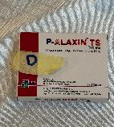
Product D
Note: update with project country currency and pricing.
This product has not been out of stock since December 2023. They sell on average 4 packs per month, but can’t remember what happened last week. They sell them for XX to retail customers and to wholesale customers. There is no minimum order size. When they buy them wholesale, they cost XX each. Last time they bought 10.
Brand: P-ALAXIN
Generic/ active ingredients: DIHYDROARTEMISININ PIPERAQUINE
Manufacturer + country: BLISS GVS + INDIA
Strength(s): 20MG / 960 MG
Dose form: TABLET
FDC?: YES
Salt: YES- PHOSPHATE
Pack type: INDIVIDUAL PACKET
Pack Size: 6
Quantity sold: DON’T KNOW (1 IS OK)
Stockout?: NO
Price for retail: XX
Price for wholesale: XX FOR 1
Price paid to supplier: XX FOR 1

Slide 16

Product E
Note: update with project country currency and pricing.
This is their best-selling product! They sold all their stock 2 weeks ago and it took a week to get more. They sell for XX per pack. They refuse to tell you about their wholesale practices.
Brand: AMATEM FORTE SOFTGEL
Generic/ active ingredients: ARTEMETHER LUMEFANTRINE
Manufacturer + country: OLIVE HEALTHCARE + INDIA
Strength(s): 80 MG/ 480 MG
Dose form: TABLET
FDC?: YES
Salt: NO
Pack type: INDIVIDUAL PACKAGE
Pack Size: 6
Quantity sold: NOT INDICATED, DON’T KNOW
Stockout?: YES
Price for retail: XX
Price for wholesale: REFUSED
Price paid to supplier: REFUSED

Slide 17

Product F
Note: update with project country currency and pricing.
This product rarely goes out of stock, but the provider can’t remember if it has in the past 3 months. It sells for XX to any customer type. They have sold 2 in the past week. 1 to retail and 1 to another outlet type. They buy them in lots of 5 from their wholesaler for XX each.
Brand: LYNSUNATE
Generic/ active ingredients: Artemether
Manufacturer + country: LYN-EDGE PHARMACEUTICALS + NIGERIA
Strength(s): 80 MG / 1 ML
Dose form: LIQUID INJECTION
FDC?: N/A
Salt: NO
Pack type: INDIVIDUAL PACK OR AMPOULE
Pack Size: 1 OR 6
Quantity sold: 2 PACKS***
Stockout?: NO (OR DON’T KNOW)
Price for retail: XX
Price for wholesale: XX FOR 1 PACK
Price paid to supplier: XX FOR 5 PACKS
***The scenario is not clear on if they sold two packs or two ampoules. If the pack type is selected as ampoule, all quantity and price information should be by ampoule not by pack

Slide 18

Product G
Note: update with project country currency and pricing.
The provider has sold 6 of these this week for take-away (XX). They do not offer in-house testing. Children get no discount. They were out of stock earlier this month. They buy them in batches of 50 from their supplier for XX. They do not sell to other outlets
Brand: HEALTH CHECK MALARIA PARASITE TEST CASSETTE
Manufacturer + country: ARTRON + CANADA
Parasite: Pf
Antigen: NOT INDICATED
Self-test kit?: YES
Quantity sold: 6
Stockout?: YES
Price for retail: XX FOR TAKE-AWAY ADULT AND CHILDREN; N/A FOR IN-HOUSE PRICES
Price for wholesale: N/A
Price paid to supplier: XX FOR 50

Slide 19
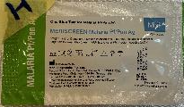
Product H
Note: update with project country currency and pricing.
The provider does not sell these for take away testing. In house, they charge XX for the test and XX for the service for adults, but only XX total (including test) for children. They are reluctant to tell you about their wholesale practices, except that last time they received 100 of these tests for free from an NGO.
Brand: MERISCREEN MALARIA PF/PAN AG
Manufacturer + country: MERIL DIAGNOSTICS PVT LTD + INDIA
Parasite: PF/PAN
Antigen: HRP2/pLDH
Self-test kit?: NOT INDICATED
Quantity sold: NOT INDICATED; DON’T KNOW
Stockout?: NOT INDICATED; DON’T KNOW
Price for retail: IN HOUSE XX FOR ADULTS AND XX FOR CHILD; N/A FOR TAKE-AWAY
Price for wholesale: REFUSED
Price paid to supplier: XX FOR 100

